Slide 1

Lock
Computer System Engineering, Fall 2017. (IPADS, SJTU)
Before-or-after
Yubin Xia

Slide 2

Virtualization: C/S on a Single Machine
in order to enforce modularity + build an effective operating system
programs shouldn’t be able to refer to
(and corrupt) each others’ memory
Virtual memory
programs should be able to
communicate
Bounded buffer (virtualize communication links)
programs should be able to share a
CPU without one program halting the
progress of the other
Assume one program per CPU (for today)

Slide 3
Implementing the Lock

Slide 4
Lock Implementation (Incorrect)
struct lock { integer state; };
void acquire (lock refrerence L) {
while L.state == LOCKED
; // spin until L is UNLOCKED
L.state = LOCKED; // the while test failed, got the lock
}
void release (lock reference L) {
L.state = UNLOCKED;
}

Slide 5
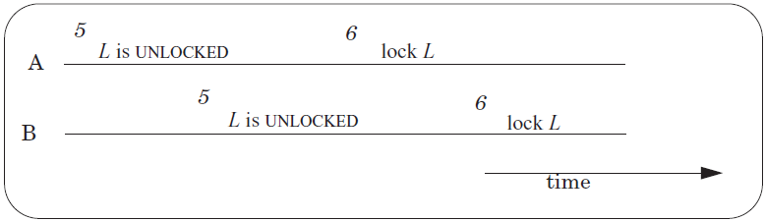
Race Condition Still Exists!
A and B both have the Lock!
Operation-1: Read L to check if its state is LOCKED
Operation-2: Write L to change its state to LOCKED
Not atomic!
Need another lock?
Notes:
How do you handle this in Lab-1?

Slide 6
Primitives to Implement Lock
Software solution
Using load and store instructions only
Dekker’s & Peterson’s Algorithms
Hardware atomic instruction
RSM: read-set-memory
Test-and-set, Compare-and-swap
Load-linked + Store-conditional, Fetch-and-add

Slide 7
Peterson’s Algorithms
int flag[2]; // assume two threads on two CPUs
int turn;
void init() {
flag[0] = flag[1] = 0; // 1->thread wants to grab lock
turn = 0; // whose turn? (thread 0 or 1?)
}
void lock() {
flag[self] = 1; // self: thread ID of caller
turn = 1 - self; // make it other thread’s turn
while ((flag[1-self] == 1) && (turn == 1 - self))
; // spin-wait
}
void unlock() {
flag[self] = 0; // simply undo your intent
}

Slide 8
Peterson’s Algorithms
Assumptions
Assume loads and stores are atomic with respect to each other, which was true on early hardware
Does not hold on today’s hardware, which has relaxed memory consistency models
So, not used any more
Using a little hardware support is much easier

Slide 9
Test-and-set Instruction
History
Burroughs B5000 in the early 1960’s
1 int TestAndSet(int *old_ptr, int new) {
2 int old = *old_ptr; // fetch old value at old_ptr
3 *old_ptr = new; // store ’new’ into old_ptr
4 return old; // return the old value
5 }

Slide 10
Spin Lock using Test-and-set
1 typedef struct __lock_t {
2 int flag;
3 } lock_t;
4
5 void init(lock_t *lock) {
6 // 0 indicates that lock is available, 1 that it is held
7 lock->flag = 0;
8 }
9
10 void lock(lock_t *lock) {
11 while (TestAndSet(&lock->flag, 1) == 1)
12 ; // spin-wait (do nothing)
13 }
14
15 void unlock(lock_t *lock) {
16 lock->flag = 0;
17 }

Slide 11
Compare-and-swap
Another hardware primitive
Compare-and-swap (on SPARC)
Compare-and-exchange (on x86)
1 int CompareAndSwap(int *ptr, int expected, int new) {
2 int actual = *ptr;
3 if (actual == expected)
4 *ptr = new;
5 return actual;
6 }

Slide 12
Spin Lock using Compare-and-swap
1 typedef struct __lock_t {
2 int flag;
3 } lock_t;
4
5 void init(lock_t *lock) {
6 // 0 indicates that lock is available, 1 that it is held
7 lock->flag = 0;
8 }
9
10 void lock(lock_t *lock) {
11 while (CompareAndSwap(&lock->flag, 0, 1) == 1)
12 ; // spin-wait (do nothing)
13 }
14
15 void unlock(lock_t *lock) {
16 lock->flag = 0;
17 }

Slide 13
Load-linked and Store-conditional
1 int LoadLinked(int *ptr) { 2 return *ptr; 3 } 4 5 int StoreConditional(int *ptr, int value) { 6 if (no one has updated *ptr since the LoadLinked to this address) { 7 *ptr = value; 8 return 1; // success! 9 } else { 10 return 0; // failed to update 11 } 12 }

Slide 14
Using LL/SC to Build a Lock
1 void lock(lock_t *lock) {
2 while (1) {
3 while (LoadLinked(&lock->flag) == 1)
4 ; // spin until it’s zero
5 if (StoreConditional(&lock->flag, 1) == 1)
6 return; // if set-it-to-1 was a success: all done
7 // otherwise: try it all over again
8 }
9 }
10
11 void unlock(lock_t *lock) {
12 lock->flag = 0;
13 }

Slide 15
Fetch-and-add Instruction
1 int FetchAndAdd(int *ptr) {
2 int old = *ptr;
3 *ptr = old + 1;
4 return old;
5 }

Slide 16
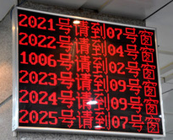
Using Fetch-and-add for Ticket Lock
1 typedef struct __lock_t {
2 int ticket;
3 int turn;
4 } lock_t;
5
6 void lock_init(lock_t *lock) {
7 lock->ticket = 0;
8 lock->turn = 0;
9 }
10
11 void lock(lock_t *lock) {
12 int myturn = FetchAndAdd(&lock->ticket);
13 while (lock->turn != myturn)
14 ; // spin
15 }
16
17 void unlock(lock_t *lock) {
18 lock->turn = lock->turn + 1;
19 }
One difference with previous locks: it ensures progress for all threads

Slide 17
Bootstrapping
Solve the narrow problem using some specialized method
Might work for only that case
It takes advantage of the specific situation
The general solution then consists of two parts:
a method for solving the special case
a method for reducing the general problem to the special case

Slide 18
Bootstrapping (In the case of ACQUIRE)
The solution for the specific problem is
Hardware: building a special hardware instruction that is itself is a before-or-after action
Software: by some extremely careful programming

Slide 19
Assumptions
Bus arbiter
Guarantees that any single LOAD or STORE is a before-or-after action with respect to every other LOAD and STORE
Each entry of the shared array is:
in its own memory cell
the memory provides read/write coherence for memory cells
The instructions execute in program order

Slide 20

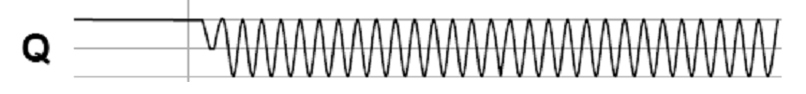
The Bus Arbiter Problem
A:
Arbiter
S:
A:
B:
Clock:
B:
Clock:
S:
t_{E}
Two async inputs (A, B), one sync output
Choose between two asynchronous input
If inputs are closely spaced
Output may be oscillating
Waiting longer only reduce the probability of oscillating

Slide 21
Lock Performance

Slide 22
Lock Granularity
Systems can be distinguished by number of locks and the amount of share data they protect
Developer must choose a locking scheme to provides the need amount of concurrency
Frequently concurrency leads to complexity

Slide 23
Lock Granularity
Course-grain – Few locks protecting more data
+ Simpler, easier to reason about
- Less concurrency
Fine-grain – Many locks protecting smaller pieces of data
+ High amount of concurrency
- More complex
- Overhead for locks

Slide 24
Example: Locks for File System
Consider a file system that has a move() function
Move a file from one directory to another
Step-1: removing the file from directory 1
unlink from directory 1
Step-2: Place the file in directory
link to directory 2
move(dir1, dir2, filename)
unlink(dir1, filename)
link(dir2, filename)

Slide 25
Approach 1: Coarse-grained Locking
move(dir1, dir2, filename):
acquire(fs_lock)
unlink(dir1, filename)
link(dir2, filename)
release(fs_lock)
fs_lock: one lock per file system
Forbid possible concurrency:
move(dir1, dir2, file1.txt)
move(dir3, dir4, file2.txt)

Slide 26
Approach 2: Fine-grained Locking
move(dir1, dir2, filename):
acquire(dir1.lock)
unlink(dir1, filename)
release(dir1.lock)
acquire(dir2.lock)
link(dir2, filename)
release(dir2.lock)
Where is the file?

Slide 27
Approach 3: Fine-grained Locking + Holding Both Locks
move(dir1, dir2, filename):
acquire(dir1.lock)
acquire(dir2.lock)
unlink(dir1, filename)
link(dir2, filename)
release(dir1.lock)
release(dir2.lock)
A: move(M, N, file1.txt)
B: move(N, M, file2.txt) // M and N swapped
Deadlock!
Notes:
A will first acquire the lock for M. Concurrently, suppose B acquires
its first lock, which is for N. Now, A needs to acquire a lock for N,
and B needs to acquire a lock for M. But they can't! The other CPU
holds the lock, and won't release it.

Slide 28

Deadlock

Slide 29
Deadlock
If we had modified the code so that both threads acquire the locks in the same order
(L1 and then L2, or vice versa)
No deadlock could have occurred
Again, small changes in the order of statements can result in good or bad behavior

Slide 30
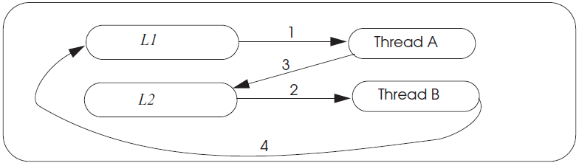
Deadlock wait-for Graph

Slide 31
Deadlock Theory
Four necessary and sufficient conditions for deadlock
Limited access
Resource can only be shared with finite users.
No preemption
Once resource granted, cannot be taken away.
Multiple independent requests (hold and wait)
Don’t ask all at once (wait for next resource while holding current one)
Cycle in wait for graph

Slide 32
Deadlock & Making Progress
Inevitable if using locks in concurrency
1. Waiting for one another
2. Waiting for a lock by some deadlocked one
Correctness arguments ensures correctness, but no progress
Methods
Pessimistic ones: take a priori action to prevent
Optimistic ones: detect deadlocks then fix up

Slide 33
Methods for Solving Deadlock
Lock ordering (pessimistic)
Number the locks uniquely
Require transactions acquire locks in order
Problem: some app may not predict all of the locks they need before acquiring the first one

Slide 34
Methods for Solving Deadlock
Backing out (optimistic)
Allow acquire locks in any order
If it encounters an already-acquired lock with an number lower than one it has previously acquired itself, then
UNDO: Back up to release its higher-numbered locks
Wait for the lower-numbered lock and REDO

Slide 35
Methods for Solving Deadlock
Timer expiration (optimistic)
Set a timer at begin_transaction, abort if timeout
If still no progress, another one may abort
Problem: how to chose the interval?

Slide 36
Methods for Solving Deadlock
Cycle detection (optimistic)
Maintain a wait-for-graph in the lock manager
Shows owner and waiting ones
Check when transaction tries to acquire a lock
Prevent cycle (deadlock)
Select some cycle member to be a victim

Slide 37
Approach 4: Fine-grained Locking + Solving Deadlock
move(dir1, dir2, filename):
if dir1.inum < dir2.inum:
acquire(dir1.lock)
acquire(dir2.lock)
else:
acquire(dir2.lock)
acquire(dir1.lock)
unlink(dir1, filename)
link(dir2, filename)
release(dir1.lock)
release(dir2.lock)
dir.inum is the inumber of a directory
Requires global reasoning about all locks
Need a way to ensure locks are acquired in the same order
Aka., ordered locking

Slide 38
Livelock
An interaction among a group of threads
Each thread is repeatedly performing some operations
E.g., context saving/restoring
But never able to complete the whole sequence of operations
E.g., process the network packets

Slide 39
One-writer Principle
If each variable has only one writer
Coordination becomes easier
Concurrency and read-only data is easy
Guide: Make as much data as you can have only a single writer
Privatization: Make data private to a thread
Allocate on thread stack
Array indexed by thread_id()
E.g. privateData[thread_id()]...
Focus locking scheme on data shared read/write

Slide 40
Reference
Our text book: Chap-5.2
3-easy-pieces: Chap-28

